Slide 1
Solving a Sudoku with Physics
Tim Hargreaves
Notes:
Welcome to talk
Pre-recorded to avoid any technical issues
All speakers in live chat
Ask questions there
Or comment after video
Start with motivating question

Slide 2
Yes
Q: Can we solve a sudoku by randomly guessing numbers?

Slide 3
5,472,730,538
6.67×10e21
(ignoring transformations)
Number of Sudoku grids
Notes:
Finite number of games
Just a lot of them
If clever can reduce this number
Lot of hard work for little gain

Slide 4
Yes*
Q: Can we solve a sudoku by randomly guessing numbers efficiently?
*For select definitions of efficient
Notes:
Revise question

Slide 5
AGENDA
01
02
03
04
Lessons from Nature
Simulated Annealing
Examples of optimisation in the natural world
Turning physics into an algorithm
Solving a Suduko
Going Beyond
Applying simulated annealing to a sudoku
Other applications and further reading

Slide 6
01
Lessons from Nature
Notes:
Two examples of natures ability to optimise systems

Slide 7
Lesson One: Soap
Q: What is the cheapest* way to connect four villages located on the corners of a unit square?
A
B
C
C
Total: ~2.83
Total: 3
Total: 4
*Least amount of road used

Slide 8
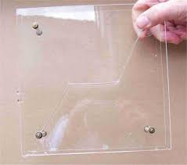
Lesson One: Soap
A
B
C
C
Total: ~2.73
(<2.83)

Slide 9
Lesson Two: Evolution
Q: How do instruct a bipedal robot to walk?

Slide 10
02
Simulated Annealing

Slide 11
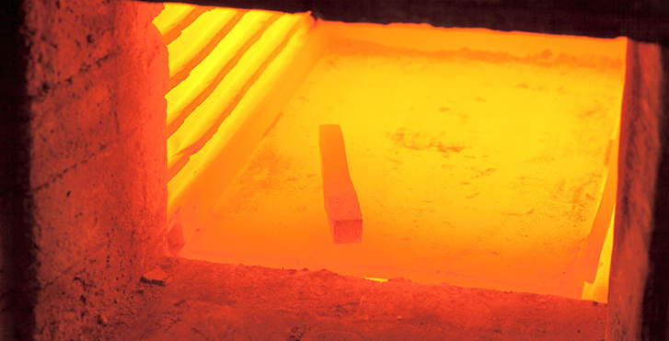
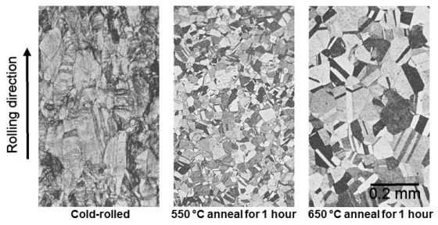
The Real Deal
Treatment used to improve structure of a material
Heated above recrystallisation temperature
Atoms can move around the crystal lattice, stabilising as the material cools

Slide 12
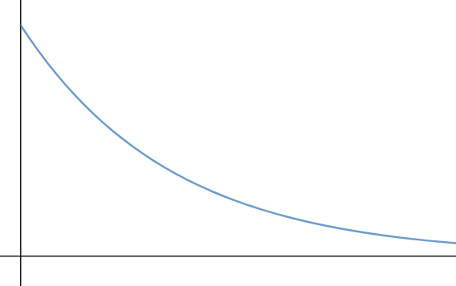
Taking Inspiration
Start with random state and hot temperature
Make small changes to the solution
Randomly accept changes based on temperature and improvement
Reduce temperature with time
Temperature
Time

Slide 13
“Blind luck on steroids.”

Slide 14
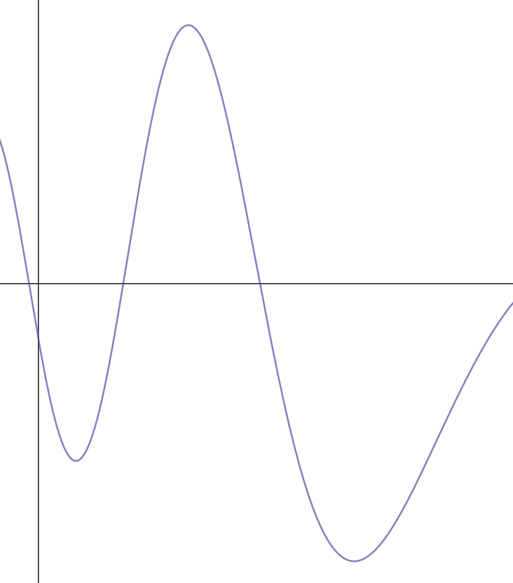
A Rough Example
Cost
Temperature
Dial Position
Time

Slide 15
03
Solving a Sudoku

Slide 16
That’s So Random
Initial random state will consist of randomly filling each 3x3 square with remaining numbers
To update state, select random 3x3 square and swap any two non-fixed cells at random
6
1
3
4
8
5
2
9
7

Slide 17
Measuring Success
Mistakes: 3
1
Count how many mistakes lie in each row and column
Add these together to obtain a total cost
One mistake is added for each duplication of a number
A perfectly solved sudoku would have a cost of zero
8
9
1
3
7
3
8
1

Slide 18
Is It Hot In Here?
We also need to define:
Starting temperature
Cooling rate
Iterations per temperature
These are non-essential so we will skip over them

Slide 19
Annealing in Action
https://bit.ly/353CIRi

Slide 20
Comments
Far faster than brute fast
No where near optimal
Improvements to code
Constrained optimisation/backtracking combination would do much better
Worth it for simplicity/generality?

Slide 21
04
Going Beyond

Slide 22




Other Applications
Rubik’s Cube
Scheduling Problems
Travelling Salesman Problem
Function Minimisation

Slide 23
Further Reading
The Traveling Salesman with Simulated Annealing, R, and Shiny — T. W. Schneider
Simanneal package — M. Perry
Simulated Annealing — D. Bertsimas & J. Tsitsiklis
Sudoku as a Constraint Problem — H. Simonis
The Art of Computer Programming — D. E. Knuth

